Slide 1


Java-Based Digital Banking Fraud Detection & Simulation Engine
Presented by : Gokul M
Batch -11

Slide 2

Problem Statement: The Digital Banking Threat
The Challenge
The Solution
Digital banking platforms face an escalating threat from sophisticated fraud tactics. Traditional rule-based systems struggle to detect emerging fraud patterns while generating excessive false positives that overwhelm security teams.
This fraud detection engine combines multiple detection mechanisms with automated testing capabilities. It provides real-time risk scoring, visual dashboards, and a simulation module that generates test transactions for continuous model improvement.
Key pain points:
Core benefits:
Volume-based attacks bypassing simple rules
False positives draining security resources
Difficulty in testing fraud scenarios safely
Limited historical training data
Adaptive detection using hybrid rules + ML
Comprehensive analytics dashboard
Safe simulation environment
Exportable training data

Slide 3

Hybrid Fraud Detection: Rules, ML & Real-time Monitoring
Rule-Based Detection
Machine Learning (ML) Based Detection
Our system employs predefined business rules to identify common fraud patterns and suspicious activities. This forms the foundational layer of defense, catching obvious anomalies efficiently.
Integrating a machine learning plugin allows for adaptive fraud detection. The ML model continuously learns from data, identifying subtle, complex patterns that rule-based systems might miss.
High-value transaction alerts
Rapid transaction velocity checks
Location mismatch analysis
Predictive risk scoring (0-100)
Adaptive anomaly identification
Integration with external ML models

Slide 4

Technology Stack: Powering the Engine
Java & Spring Boot
MySQL Database
RESTful APIs
A reliable and widely used relational database for storing all transaction data, fraud logs, and user information, ensuring data integrity and fast retrieval.
Enabling seamless communication between different application components and external systems. Facilitates transaction ingestion and data retrieval.
The core of our application, providing a robust and scalable framework for enterprise-grade applications. Spring Boot simplifies development and deployment of microservices.
High performance and reliability
Scalability for large datasets
ACID compliance
Standardized communication
Stateless architecture
Interoperability
Rapid application development
Microservices architecture support
Dependency Injection
This powerful combination ensures a high-performing, secure, and easily maintainable fraud detection system.

Slide 5
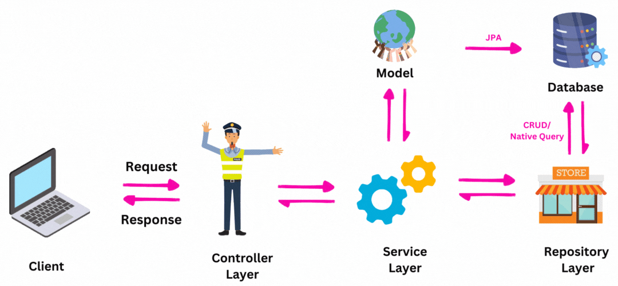
Architectural Overview

Slide 6




System Architecture: Component Overview
Presentation Layer
Thymeleaf templates rendering HTML views with dynamic data. Dashboard displays transaction metrics using Bootstrap cards while tables show fraud risk scores with color-coded status indicators.
Service Layer
Business logic handling fraud detection. The FraudDetectionService combines rule-based logic with ML predictions, generating risk scores while TransactionService manages database persistence.
ML Layer
Pluggable fraud prediction models implementing standardized interfaces. Can integrate multiple ML frameworks while providing consistent risk scoring for downstream analysis.
Repository & Database
JPA repositories abstracting database operations. TransactionRepository and FraudLogRepository handle entity persistence while supporting complex queries for rapid transaction lookups.

Slide 7
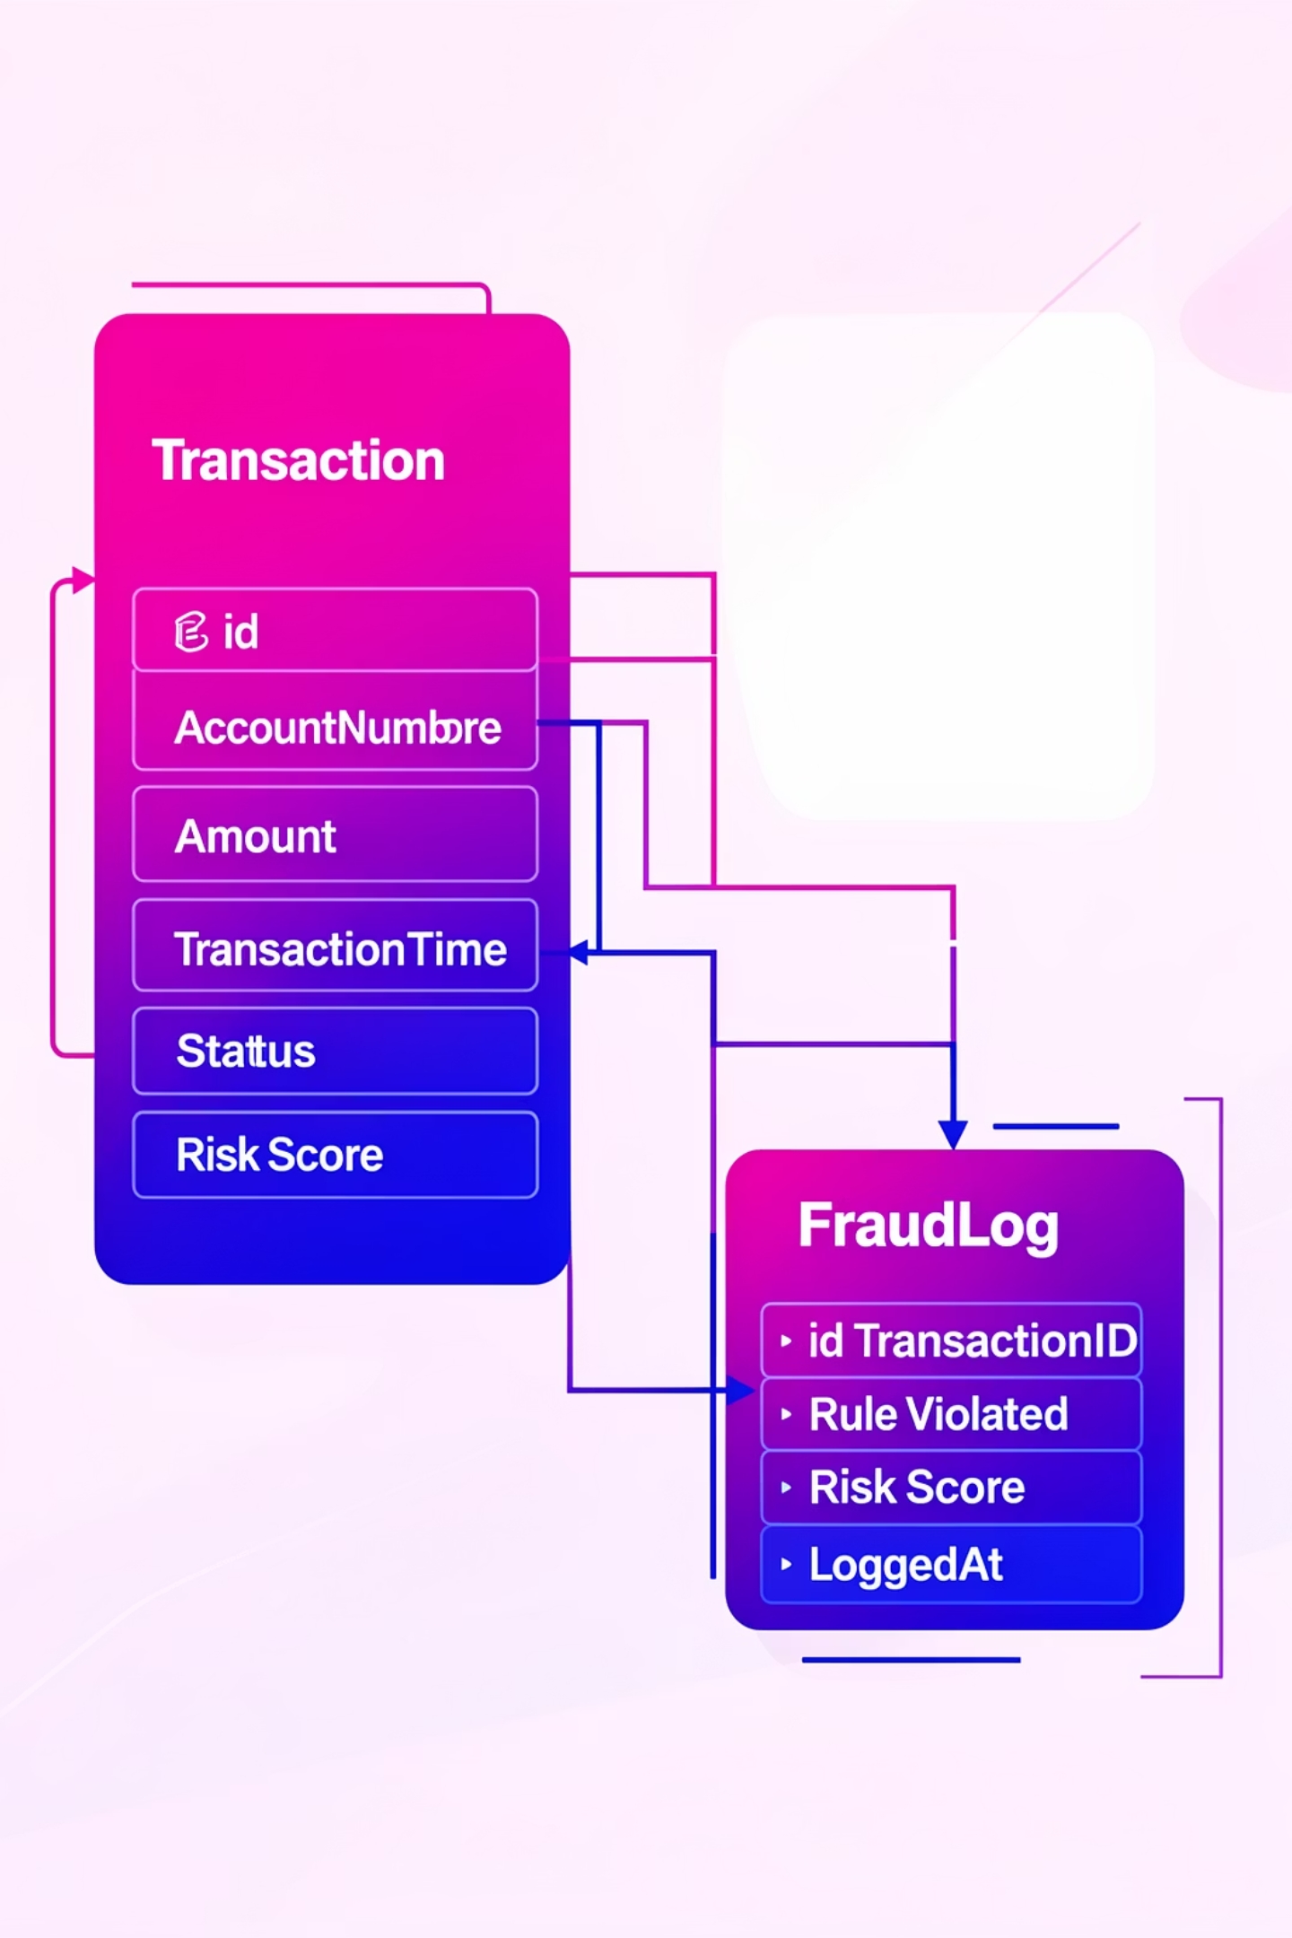
Entity-Relationship Diagram: Transaction and Fraud Log
The core entities, Transaction and FraudLog, capture essential details for every financial operation and any detected anomalies. This structure supports detailed tracking and analysis of all activities within the system.
Transaction Entity
FraudLog Entity
id: Unique identifier
accountNumber: Account involved
amount: Transaction value
location: Geographic location
transactionTime: Timestamp
status: NORMAL, SUSPICIOUS, FRAUD
riskScore: Calculated risk
id: Log identifier
transactionId: Linked transaction
ruleViolated: Rule or model triggered
riskScore: Risk at log time
loggedAt: Log timestamp

Slide 8






Layered Architecture: Separation of Concerns
1
Presentation Layer
2
API Gateway / Controller Layer
3
Service Layer
4
ML Layer
5
Repository Layer
6
Database Layer
Our application follows a layered architecture, ensuring each component has a distinct responsibility, which enhances manageability and scalability.

Slide 9




Core Components Overview
Our fraud detection system leverages a modular architecture designed for efficiency and scalability. It integrates various services and repositories to provide comprehensive monitoring and analysis of banking transactions.
Controllers
Services
Endpoints for API, dashboard, and analytics.
Business logic and fraud detection rules.
Repositories
ML Integration
Data access and persistence layers.
Machine learning plugin for risk scoring.

Slide 10

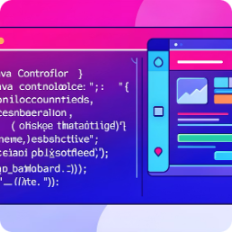
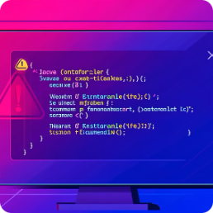
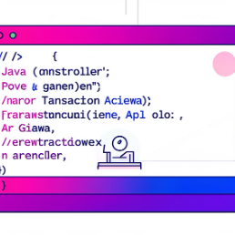
Controller Layer: Managing Requests and Responses
AnalyticsController
Handles requests related to analytical data, including exporting training data for ML model retraining and evaluation. Provides insights into the system's performance and fraud patterns.
GET /api/analytics/export
DashboardController
Manages the web-based dashboard and fraud report views. It fetches and displays transaction data, enabling administrators to monitor activities and review flagged transactions.
GET /
POST /transaction/create
GET /fraud-report
FraudController
Exposes REST endpoints for accessing fraud logs. This controller allows external systems or specific tools to retrieve detailed information about all detected fraudulent activities.
GET /api/fraud/logs
TransactionApiGatewayController
Serves as the primary entry point for external systems to interact with transactions. It supports transaction ingestion, retrieval, and bulk simulation for testing and analysis.
POST /api/gateway/transaction
GET /api/gateway/transactions
GET /api/gateway/transactions/fraud
POST /api/gateway/simulate/{count}

Slide 11



Service Layer: Business Logic Core
TransactionService
Manages the lifecycle of transactions, including creation, persistence, and retrieval. It orchestrates the fraud detection process by invoking the FraudDetectionService.
createTransaction(Transaction tx):Saves transaction, calculates risk, sets status.
getAll(): Fetches all transactions.
getFraudTransactions(): Filters and returns only fraud-flagged transactions
.
FraudDetectionService
The heart of our fraud analysis, combining rule-based checks and ML predictions to assign a risk score. It logs all detected fraudulent activities.
calculateRisk(Transaction tx): Main method for risk assessment.
calculateRuleBasedRisk(Transaction tx): Applies predefined fraud rules.
detectStatus(int riskScore): Determines transaction status (NORMAL, SUSPICIOUS, FRAUD).
AnalyticsService
Responsible for data preparation and export, specifically for generating CSV files that can be used for training and evaluating machine learning models.
exportTrainingData(): Exports all transaction data to a CSV file for analytics.
TransactionSimulationService
Facilitates the generation of synthetic transaction data for testing and simulating various fraud scenarios, crucial for robust system development and model validation.

Slide 12
ML Layer & Tools: Intelligent Fraud Prediction
FraudMLPlugin Interface
DummyFraudMLPlugin
A basic implementation of the FraudMLPlugin for demonstration. It applies simple rules (e.g., high amount, unknown location) to simulate an ML risk prediction.
Defines the contract for any machine learning model to be integrated into the fraud detection system. This ensures flexibility and easy swapping of ML models.
package com.bank.frauddetection.ml;
import com.bank.frauddetection.model.Transaction;
import org.springframework.stereotype.Component;
@Component
public class DummyFraudMLPlugin implements FraudMLPlugin {
@Override
public int predictRisk(Transaction tx) {
int risk = 0;
// High amount ML rule
if (tx.getAmount() > 60000) {
risk += 40;
}
// Unknown location ML rule
if ("UNKNOWN".equalsIgnoreCase(tx.getLocation())) {
risk += 30;
}
return Math.min(risk, 100);
}
@Override
public String modelName() {
return "Dummy-Rule-ML-Model-v1";
}
}
package com.bank.frauddetection.ml;
import com.bank.frauddetection.model.Transaction;
public interface FraudMLPlugin {
// Predict fraud risk using ML model
int predictRisk(Transaction transaction);
// Return model name
String modelName();
}
This interface promotes a modular design, allowing different ML algorithms to be plugged in.
This dummy plugin serves as a placeholder, showcasing how actual ML models would be integrated.
The ML layer provides the intelligence for adaptive fraud detection, with the flexibility to integrate advanced models as needed.

Slide 13
Database Design
The system utilizes a relational database to store critical transaction and fraud log data. Each table is meticulously designed to support rapid querying and data integrity, essential for real-time fraud analysis.
Table Name
Key Fields
Purpose
Transaction
id (PK), accountNumber, amount, location, status, riskScore
Stores all banking transaction details and their fraud assessment.
FraudLog
id (PK), transactionId (FK), ruleViolated, riskScore, loggedAt
Records specific instances where a transaction triggered fraud rules or ML models.

Slide 14
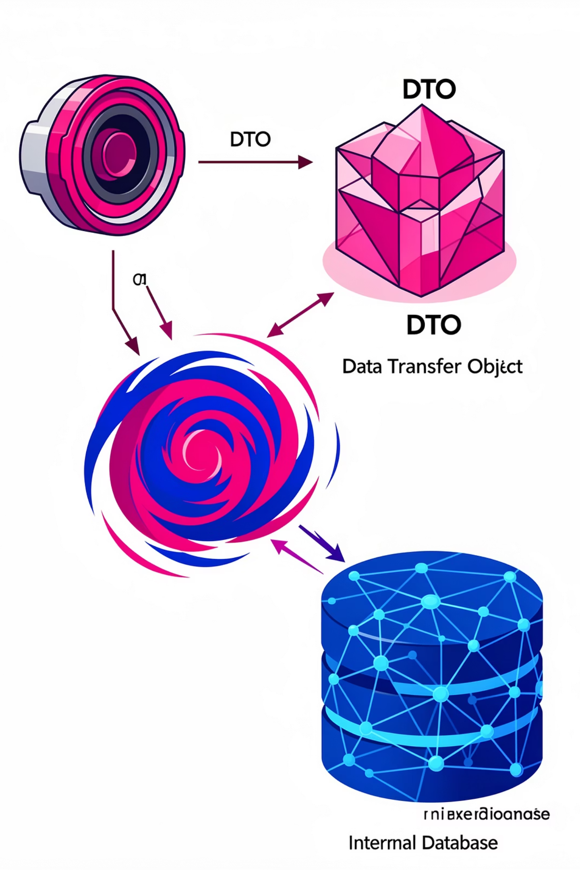
The Role of Data Transfer Objects (DTOs)
DTOs are crucial for defining how data is sent over the network, ensuring a clean separation between the external API contract and internal domain models. This enhances security, simplifies data validation, and improves performance by only transmitting necessary information.
TransactionRequestDTO.java
accountNumberamountlocation
Used for ingesting new transaction data from external sources.
Purpose of DTOs
Decouple API from internal models.
Control data exposure for security.
Optimize payload size.
Facilitate data validation at the API boundary.

Slide 15



Transaction States: Normal, Suspicious, Fraud
Transactions are dynamically categorized based on their calculated risk score, allowing for a graduated response to potential threats. This multi-tiered approach ensures that resources are allocated appropriately, from automated processing to manual review.
Fraud
1
Risk Score >= 70
Suspicious
2
Risk Score 30-69
Normal
3
Risk Score < 30
The FraudStatus enum (NORMAL, SUSPICIOUS, FRAUD) provides clear states for handling transaction outcomes.

Slide 16

Automated Transaction Simulation
The Transaction Simulation Service is a powerful tool for generating synthetic transaction data. This is invaluable for testing the fraud detection system under various conditions, enabling both automated testing and performance benchmarking.
Key Benefits of Simulation
Robust Testing: Generate high volumes of transactions to stress-test the system and validate fraud rule efficacy.
Scenario Replication: Create specific fraud patterns (e.g., high-amount, rapid transactions) to ensure detection mechanisms are robust.
Performance Benchmarking: Evaluate system response times and resource utilization under heavy load.
ML Model Training Data: Generate diverse datasets for training and improving machine learning models.

Slide 17

Simulation Flow: From API to Service
The simulation process is initiated via a dedicated API endpoint, triggering the generation of a specified number of transactions. These simulated transactions then flow through the core Transaction Service for processing and fraud assessment, mimicking real-world ingestion.
API Gateway
TransactionSimulationService
TransactionService
TransactionRepository
The TransactionApiGatewayController acts as the entry point, while TransactionSimulationService crafts realistic data, which is then handled by TransactionService for complete processing, including fraud detection and persistence.

Slide 18
Transaction Risk Reasoning
The system employs a combination of rule-based logic and machine learning to calculate a comprehensive risk score for each transaction. This hybrid approach ensures both immediate rule enforcement and adaptive, data-driven anomaly detection.
High Amount Rule (>= 50,000)
Transactions exceeding a predefined threshold are immediately flagged and contribute a significant score to the total risk, indicating a potentially fraudulent attempt.
Rapid Multiple Transactions
Multiple transactions from the same account within a short time window (e.g., 3 transactions in 2 minutes) are highly suspicious and trigger an elevated risk score.
Location Mismatch
If a new transaction's location significantly differs from previous transaction locations for the same account, it suggests potential card compromise or travel fraud.
ML Plugin Integration
A pluggable machine learning component, like DummyFraudMLPlugin, further refines the risk score based on learned patterns, adding predictive capabilities.

Slide 19

Real-time Risk Threshold Logic
The Fraud Detection Service continuously evaluates transaction risk against dynamically configurable thresholds. This flexibility allows administrators to fine-tune the system's sensitivity to fraud, adapting to evolving threat landscapes without code changes.
@Value("${fraud.ml.enabled:false}")
Enables or disables ML integration.
HIGH_AMOUNT = 50000
Configurable threshold for large transactions.
RAPID_TX_LIMIT = 3
Maximum allowed transactions in a time window.
TIME_WINDOW = 2 (minutes)
Defines the duration for rapid transaction detection.
These parameters, loaded from application.properties, allow for granular control over the fraud detection engine's behavior.

Slide 20
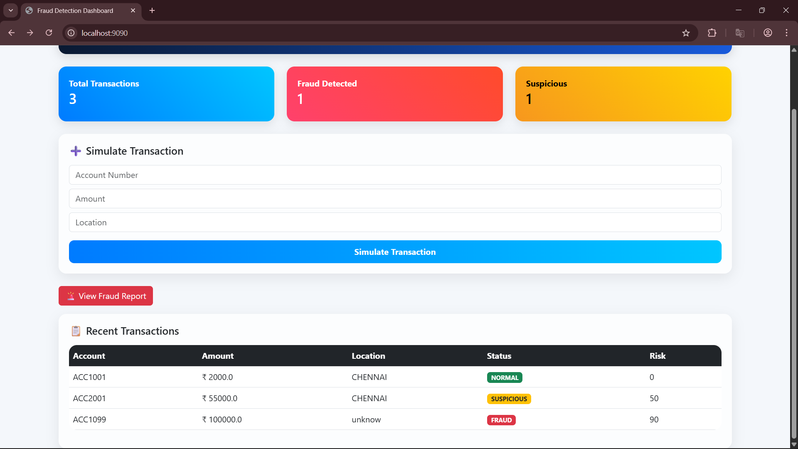

Slide 21








Scalability and Future Enhancements
The modular design of this Spring Boot application lays a robust foundation for future expansion. It's engineered to handle increasing transaction volumes and to integrate more sophisticated fraud detection mechanisms seamlessly.
Cloud Native Deployment
Advanced Analytics
Leverage microservices architecture for horizontal scaling.
Implement real-time dashboards and reporting tools.
Adaptive Rules Engine
Enhanced ML Models
Allow dynamic updates of fraud rules based on new threats.
Integrate deep learning for pattern recognition.
Our commitment is to continuous improvement, ensuring the system remains at the forefront of digital banking security.

Slide 22
Conclusion: A Comprehensive Fraud Detection Solution
What We Built
Production Ready
This Spring Boot application delivers production-ready fraud detection combining rule-based logic with extensible ML integration. Key deliverables include:
Built on battle-tested Spring Boot stack with JPA persistence and Thymeleaf templating. Architecture supports scaling from startup to enterprise banking needs through:
Real-time risk scoring during transaction processing
Dynamic fraud status classification
REST APIs for programmatic access
Interactive dashboard for monitoring
Test automation through simulation
Training data export for model improvement
Container-native design using Docker
Database peristence with transactional integrity
Thread-safe service implementations
Configurable ML model enabling/disabling
Comprehensive logging through repository layer

Slide 23
Thank You

